Slide 1
Mehul Dinesh - 22N232
Sakthivel S - 22N246
Shreeram V - 22N251
Steve B - 22N257
PROBLEM STATEMENT 1

Slide 2
PROBLEM STATEMENT
For each customer interaction it is important to identify the customers issues or request early on to be able to easily serve their needs. As mentioned above, in the airline industry there are a set of requests that come up frequently, so it would be useful to classify the initial customer messages/utterances into the most suitable request type . This is the first step in an automated customer bot. Once the request type is identified, it is shown to the customer to confirm if that's what they're looking for. If the customer agrees, it's all good from your system's point of view and the next system kicks in. If the customer disagrees, it is considered as a mistake from the system and the conversation is handed over to a real agent from the bot.
For this problem,we have build a system that can identify the customer request type from their initial messages or utterances and based on user feedback the system also able to learn from its mistakes and get better over time.

Slide 3
Objectives
Develop an automated classification system
Enhance early issue detection
Implement a customer confirmation mechanism
Design an adaptive feedback loop
Improve customer service efficiency
Evaluate system performance

Slide 4
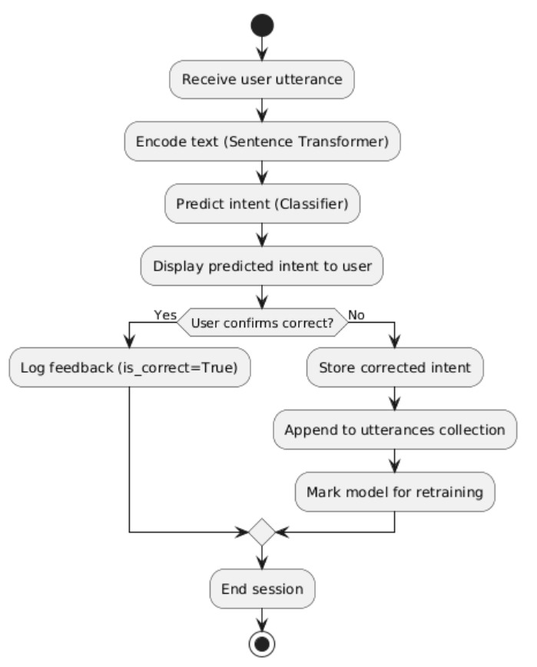
Workflow:

Slide 5
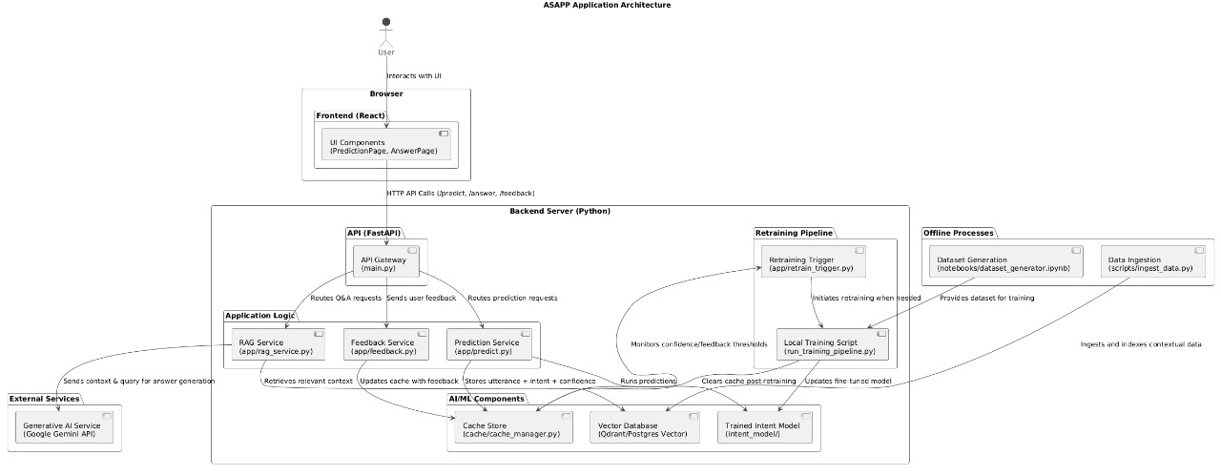
Architecture diagram:

Slide 6
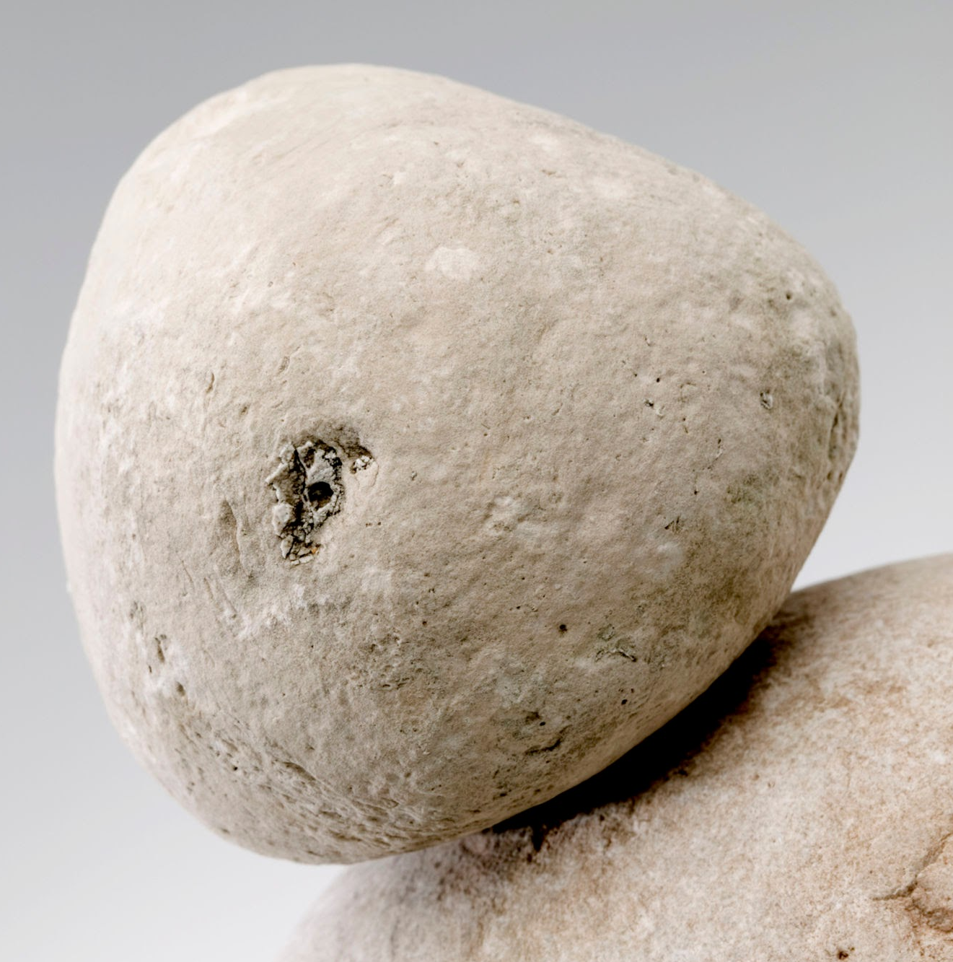



TECH STACK:

Slide 7

Model used: DistilBERT
DistilBERT is best for natural language processing (NLP) tasks that require a balance of high performance and computational efficiency, especially in resource-constrained or real-time environments. It is a smaller, faster, and cheaper version of BERT, retaining approximately 97% of BERT's performance with a 40% reduction in size.
Dataset:Synthetic Dataset
Total samples:1080 rows
Train set:864 rows
Test set:216 rows

Slide 8

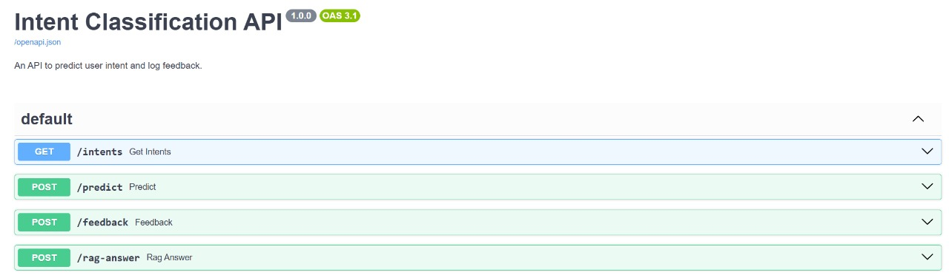
ENDPOINTS USED

Slide 9
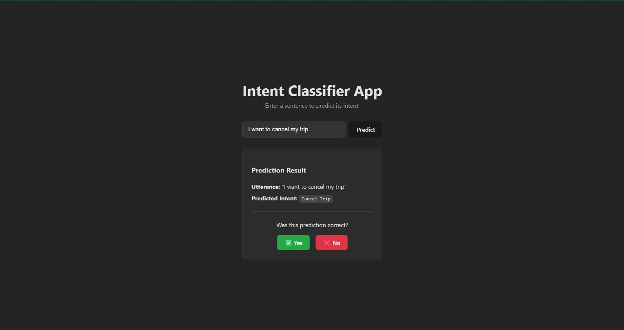
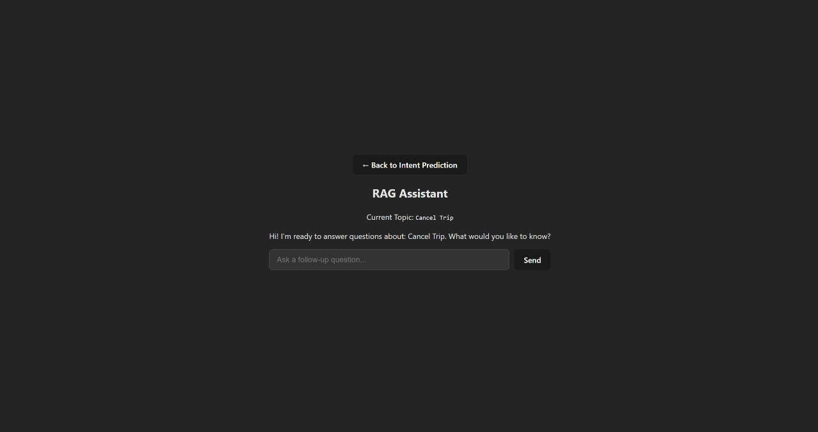
Interface

Slide 10
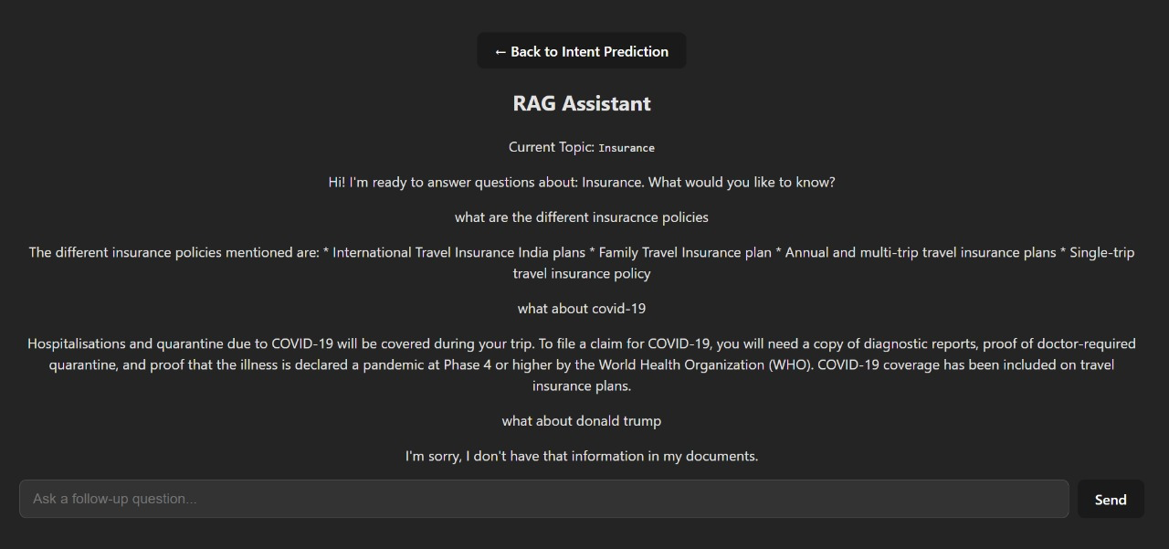
Output

Slide 11
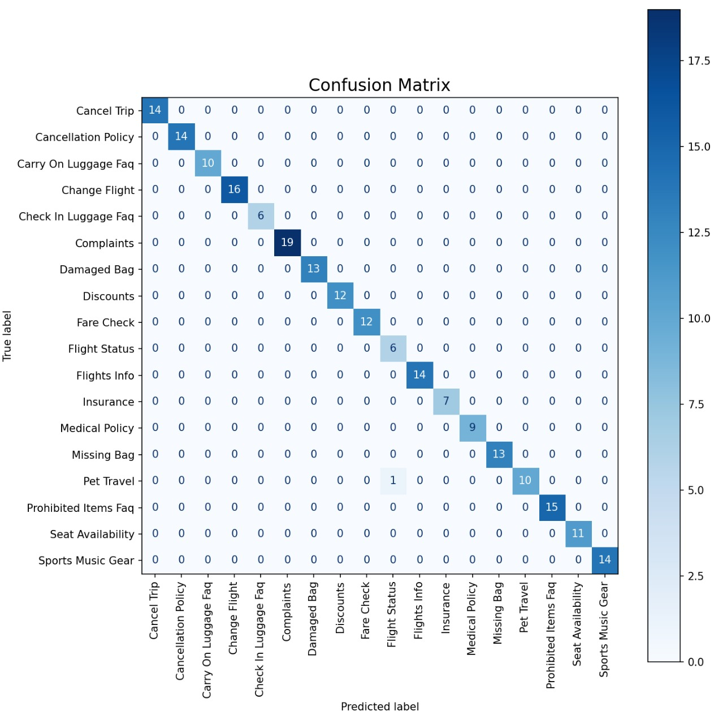
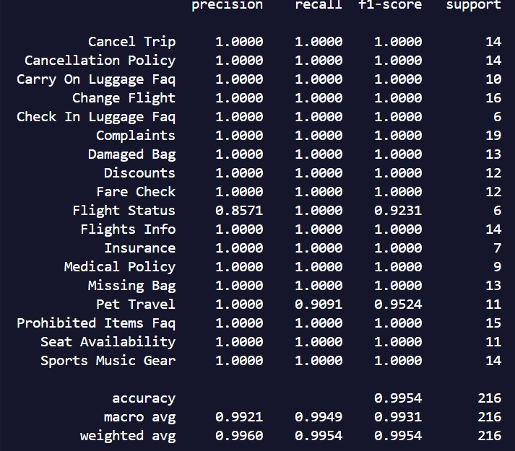
Metrics

Slide 12
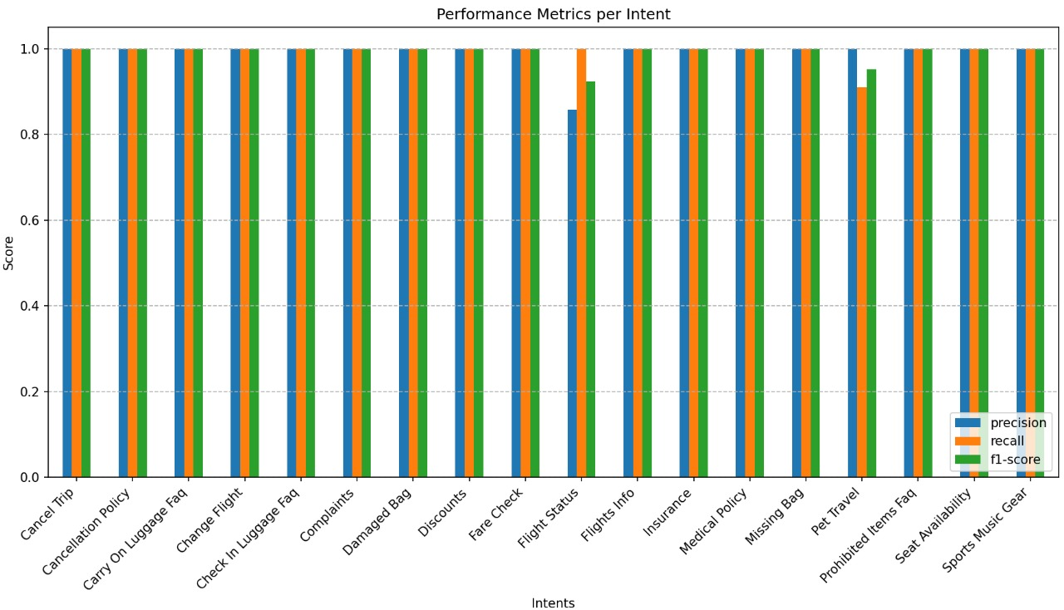
Metrics

Slide 13

Github:https://github.com/Steve-B17/Team_Kaizen.git

Slide 14
THANK YOU

